Slide 1


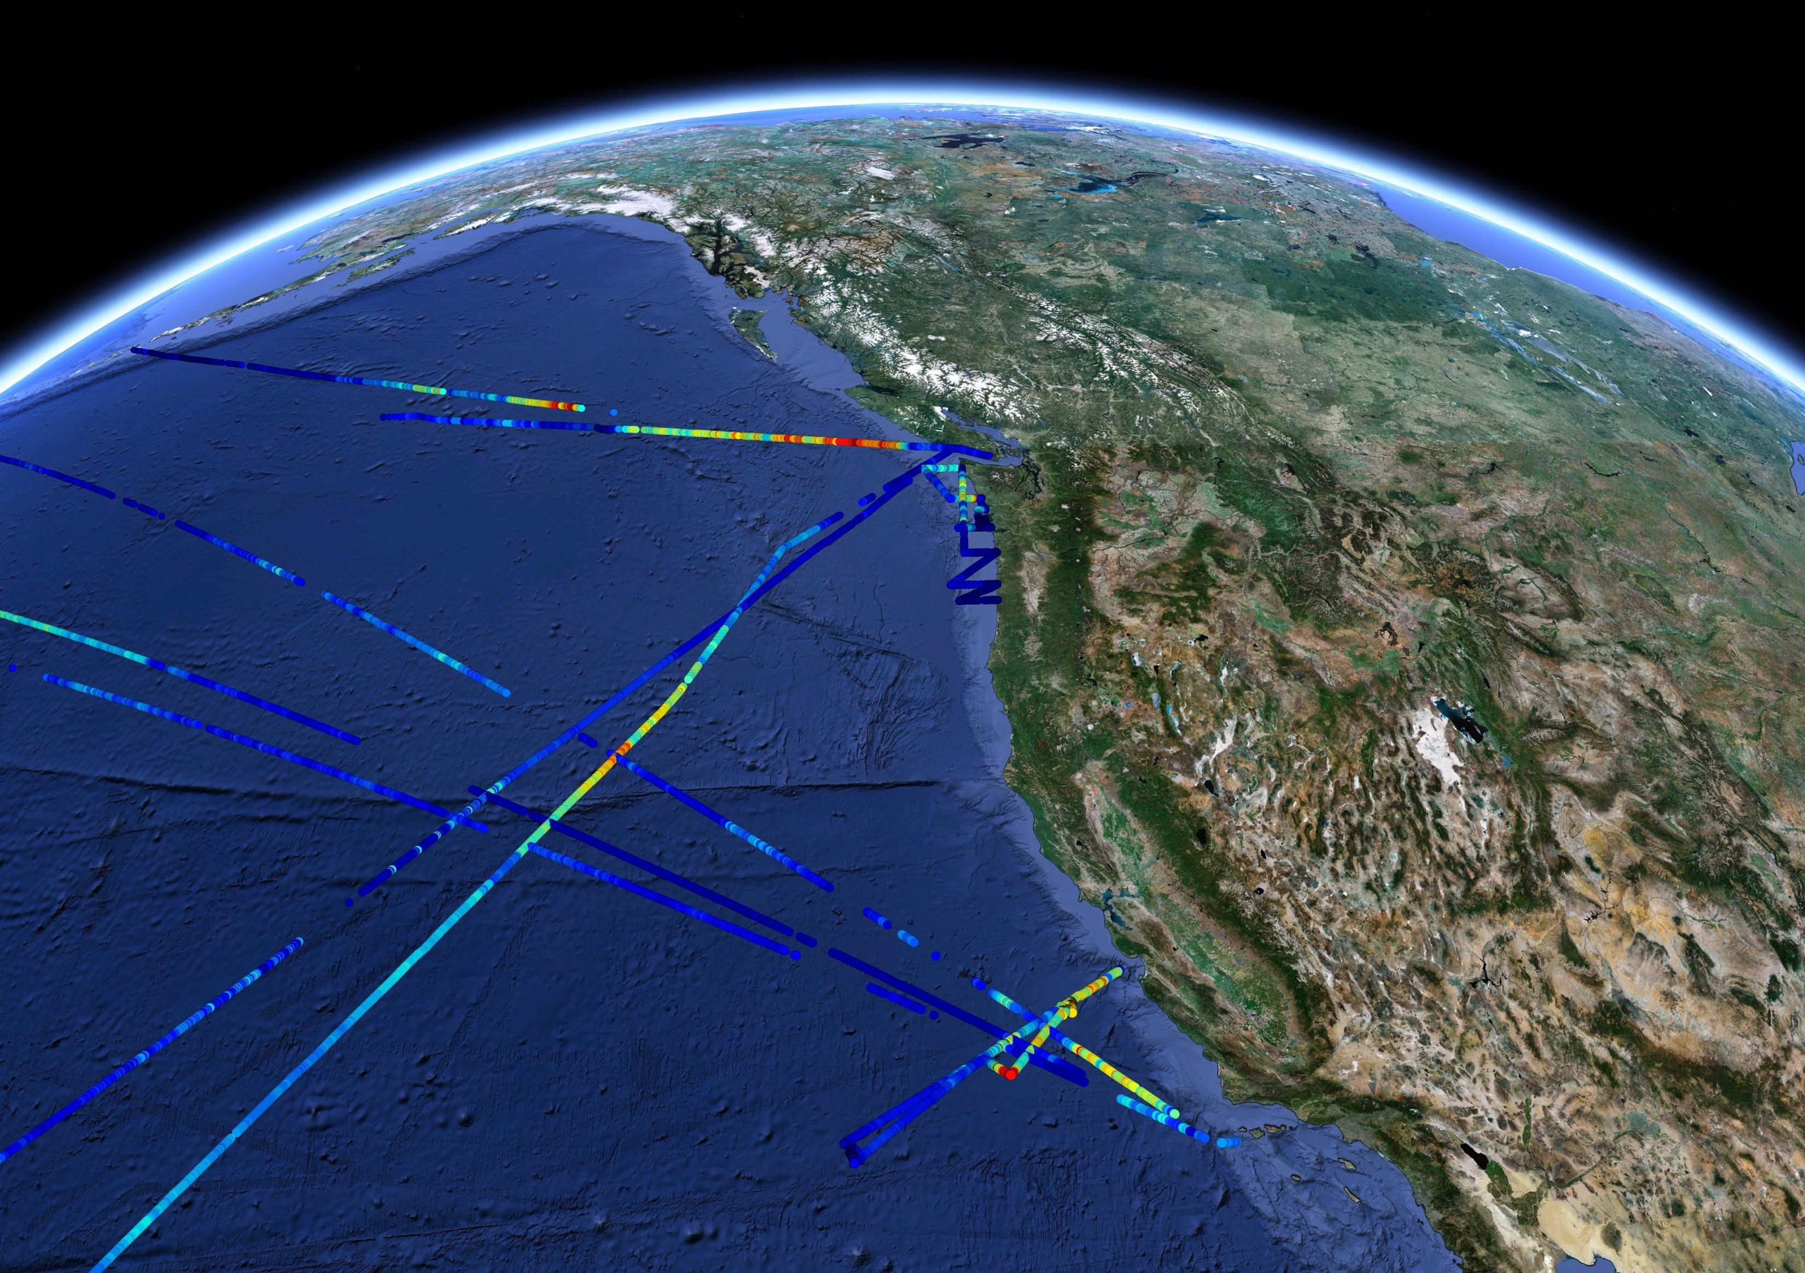


Phytoplankton growth rate
François Ribalet
ribalet@uw.edu

Slide 2
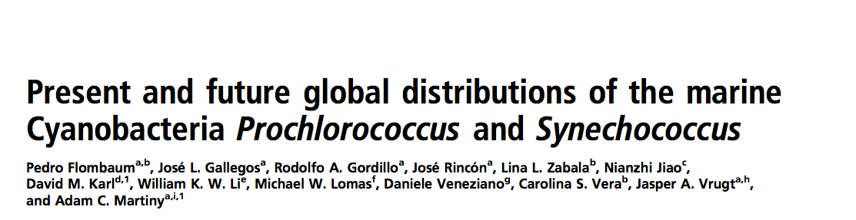
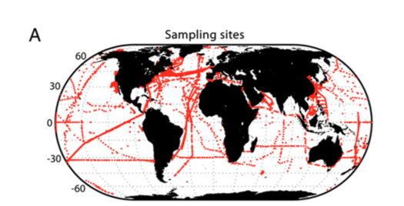
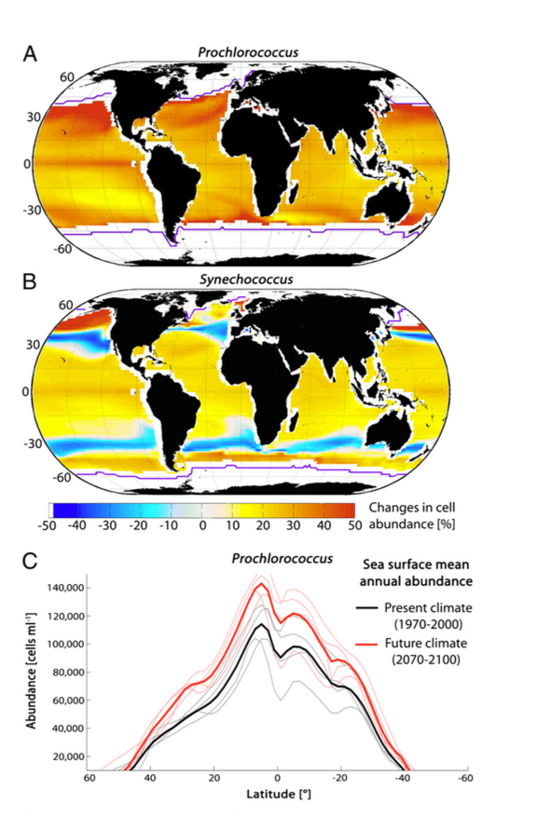
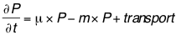
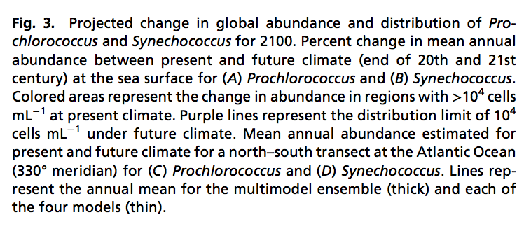
Flombaum et al., 2013 PNAS 110 9824:9829
Temperature (and light) explained most of the variance in cell abundance
By 2070-2100, 29% increase in Prochlorococcus cell abundance globally (40-50% in the NE Pacific)
Increase due to higher µ
and/or lower m ?

Slide 3

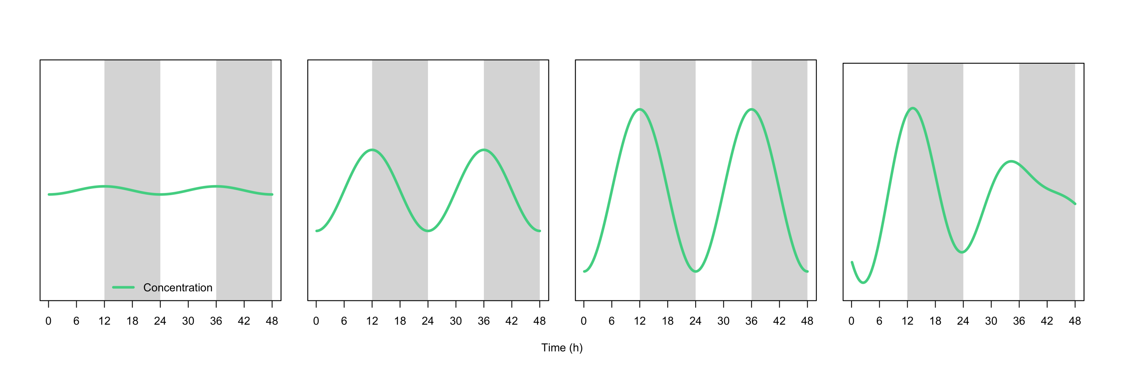
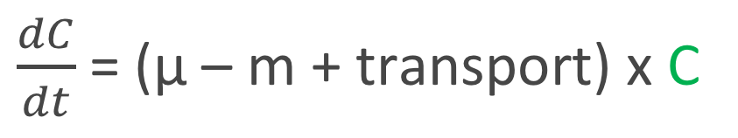
Interpretation of cell abundance
$\frac{dC}{dt}$ = (µ – m + transport) x C
Cell abundance measured at time t
concentration
Amplitude and periodicity matter

Slide 4
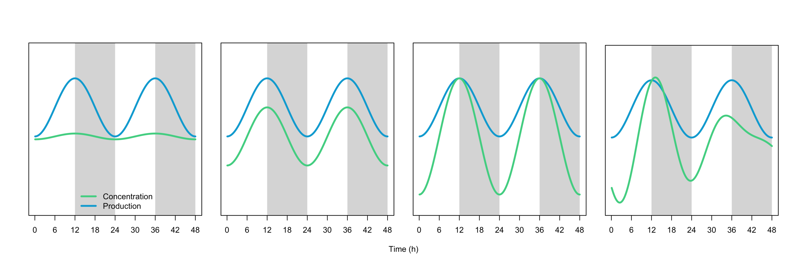
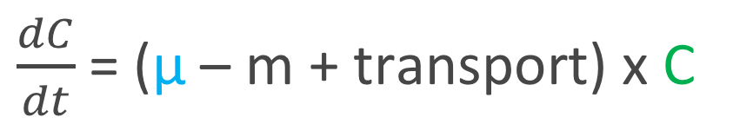
Interpretation of cell abundance
$\frac{dC}{dt}$ = (µ – m + transport) x C
Cell division rate
concentration
division

Slide 5
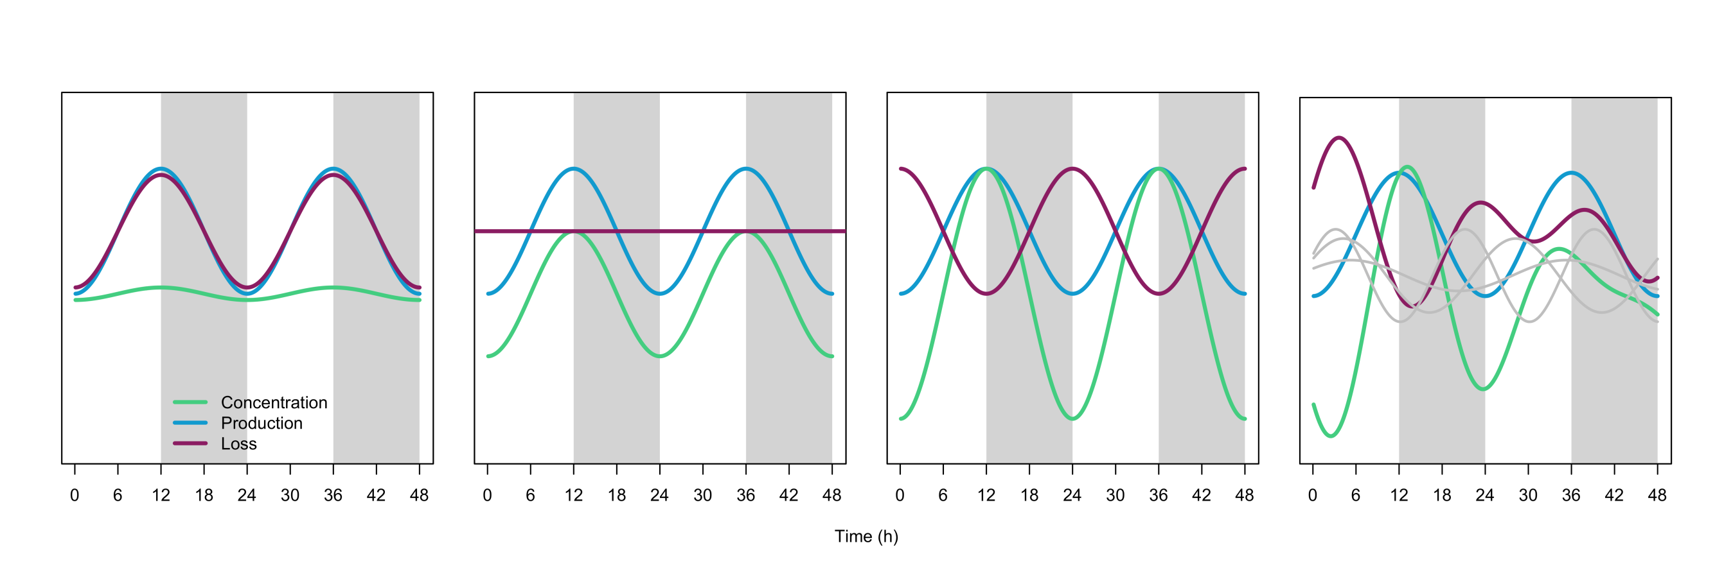
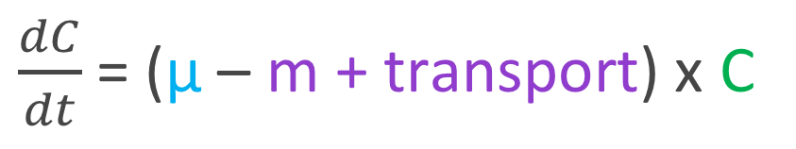
Interpretation of cell abundance
$\frac{dC}{dt}$ = (µ – m + transport) x C
Net loss rate = biotic + abiotic factors
concentration
division
loss
Rates / fluxes are key

Slide 6
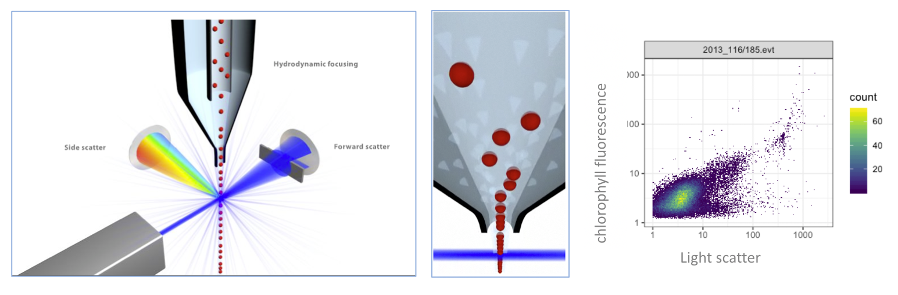
SeaFlow, a continuous flow cytometer
High speed, single-cell analysis
Multiparametric (light scattering, pigment)

Slide 7
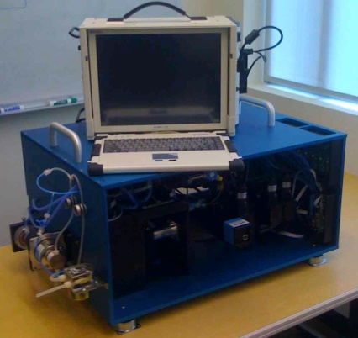
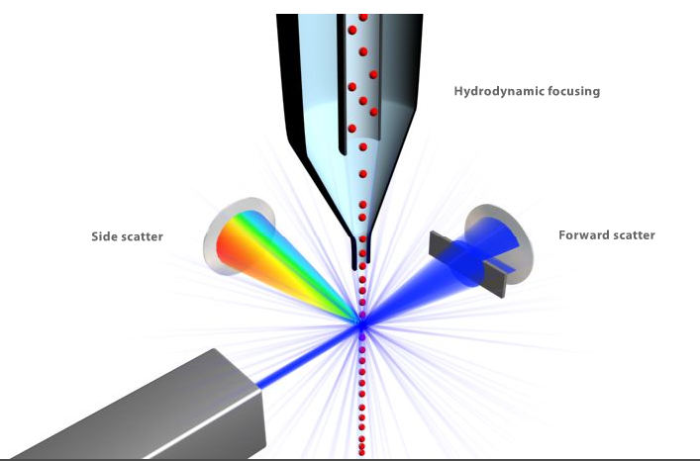
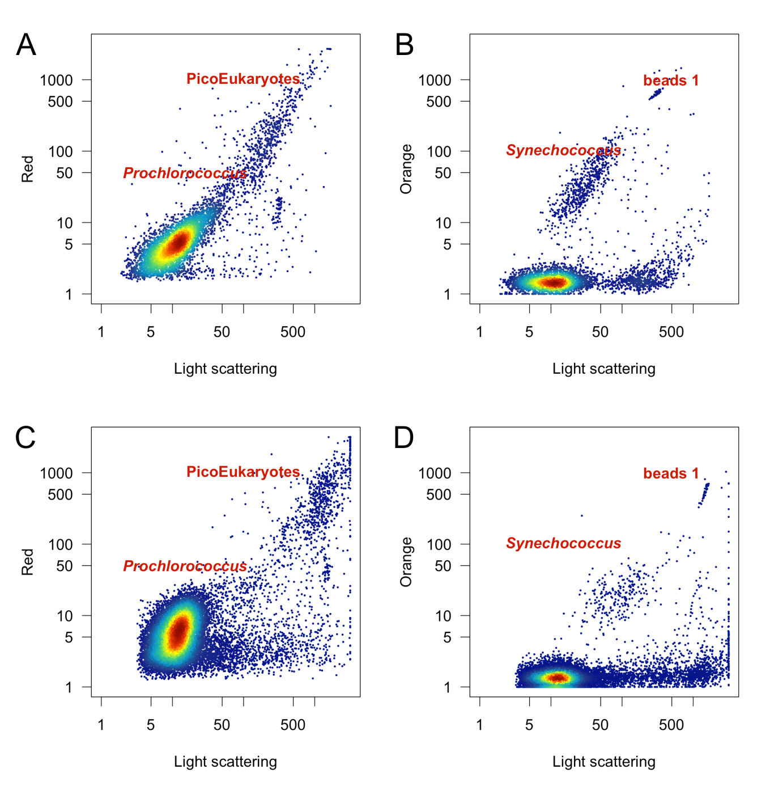
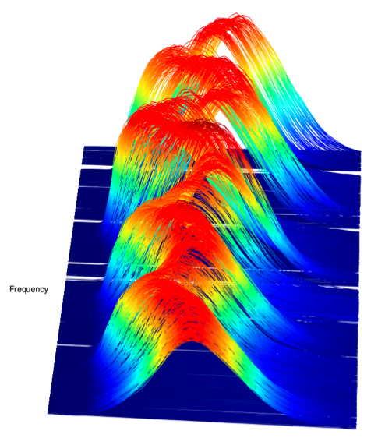
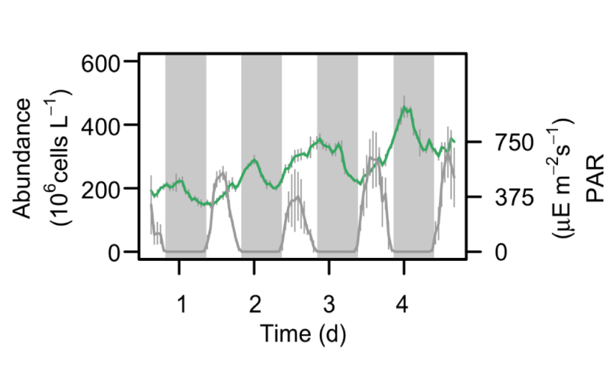
Cell abundance and size distribution measured by SeaFlow
Community structure
Cell abundance
Size distribution
* Light scattering converted to cell volume

Slide 8
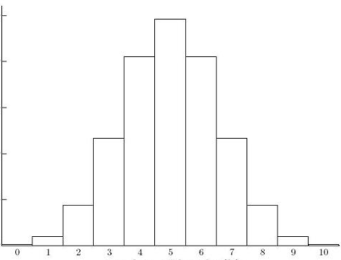
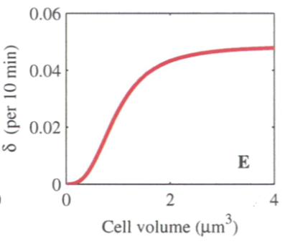
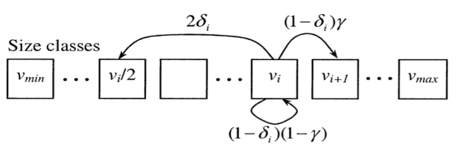
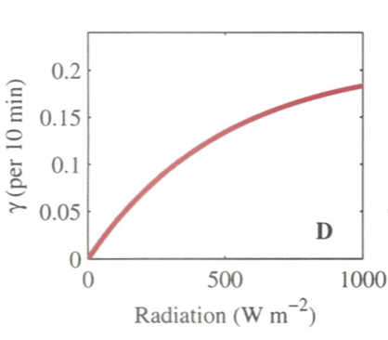
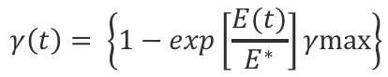
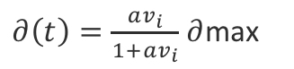
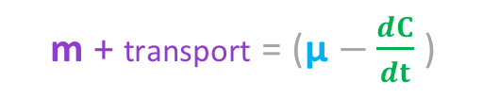
µ Size-structured matrix population model (Caswell 2000, Sosik et al. 2003)
I. INPUT
II. OPTIMIZATION
III. OUTPUT
Observed size distribution
Division depends on cell volume
Independent of cell abundance
$∂\left(t\right)=\frac{av_{i}}{1+av_{i}}$ $∂$max
Division
Growth
Growth depends on irradiance
$$γ\left(t\right)= \left\{1−exp\left[\frac{E(t)}{E^{∗}}\right]γmax\right\}$$
Stasis
irradiance
Assumptions
Respiration, grazing & viral lysis do not affect the shape of the size distribution
IV. NET LOSS RATE
m + transport = (µ $−\frac{dC}{dt}$ )

Slide 9
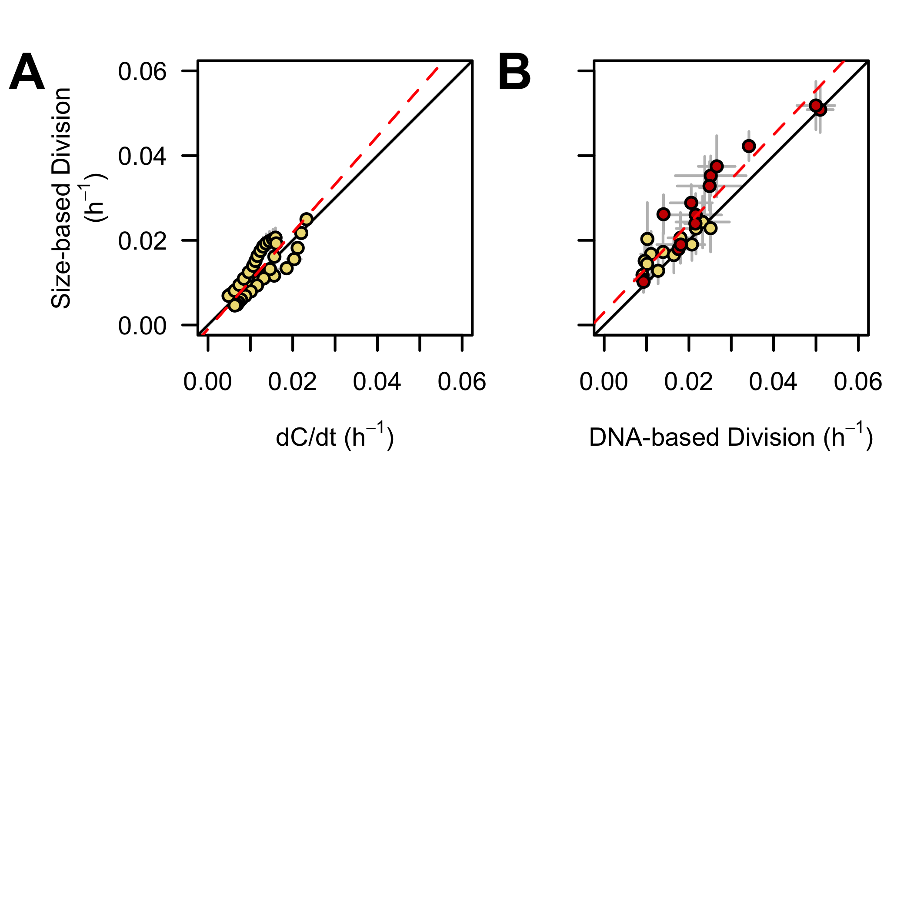
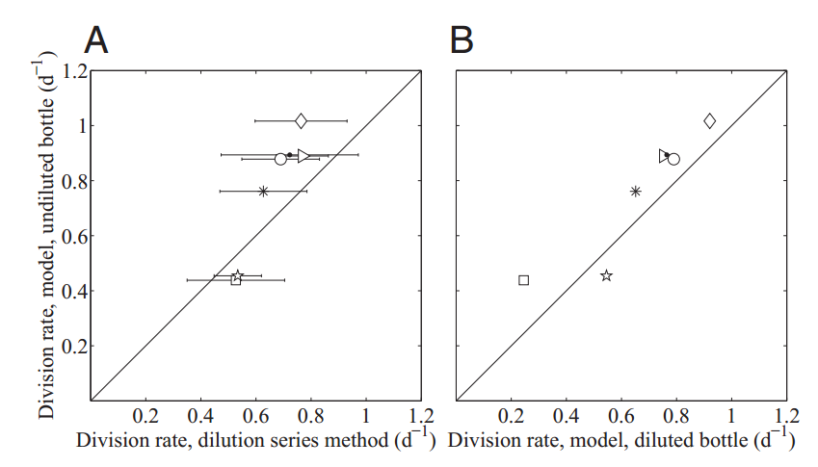
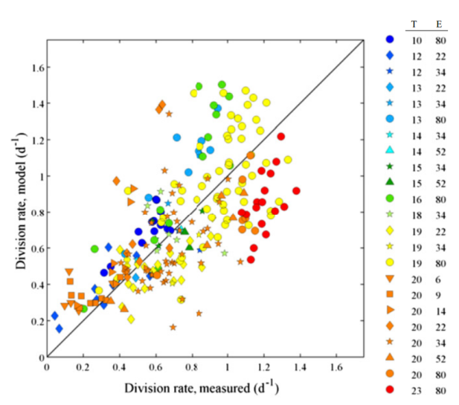
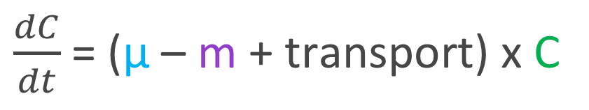
Model validation
$\frac{dC}{dt}$ = (µ – m + transport) x C
Prochlorococcus
Synechococcus
Batch culture experiment In-situ experiments
Batch culture experiment In-situ experiments
Size-based Division
(h⁻¹)
Size-based Division
(d⁻¹)
Size-based Division
(d⁻¹)
dC/dt (d⁻¹)
Dilution-based Division (d⁻¹)
(Ribalet et al. 2015)
(Hunter-Cevera et al. 2014)

Slide 10
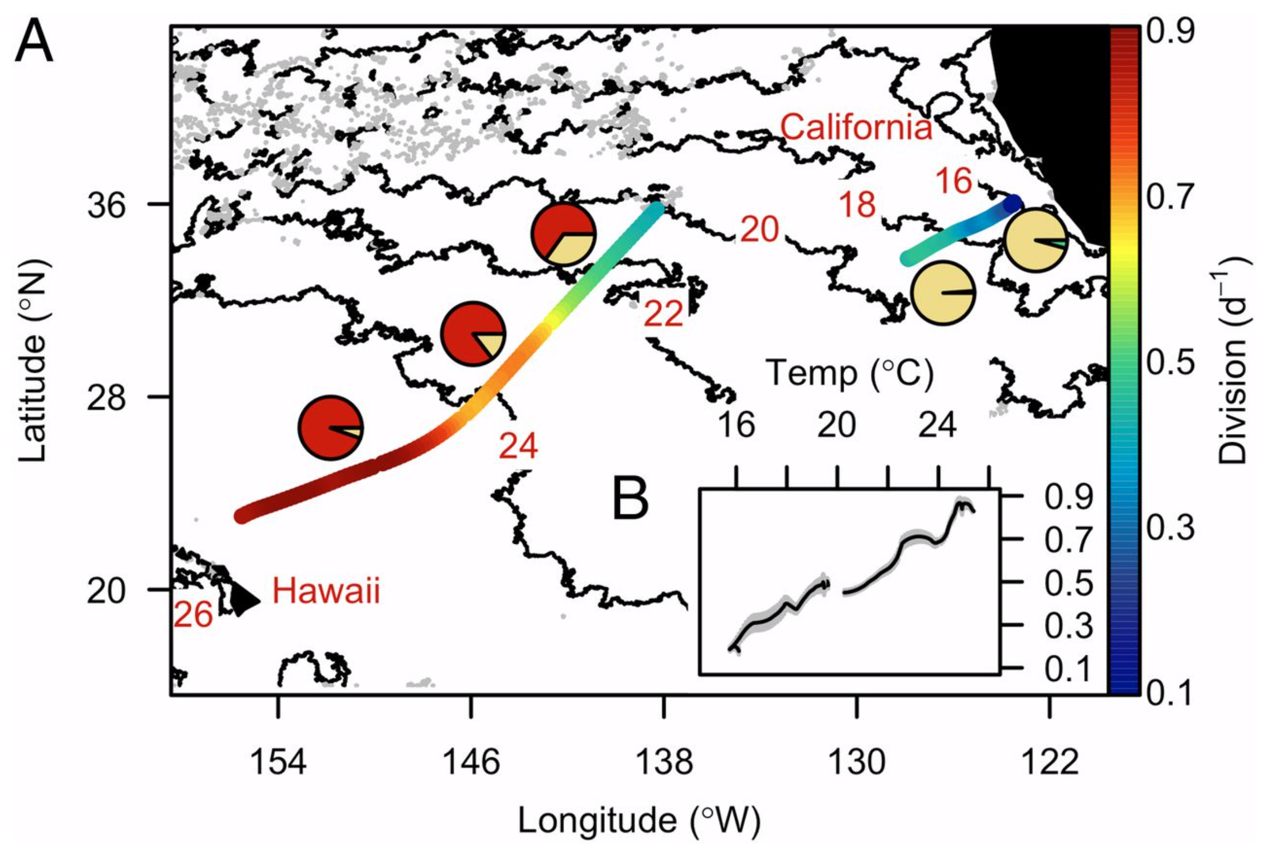
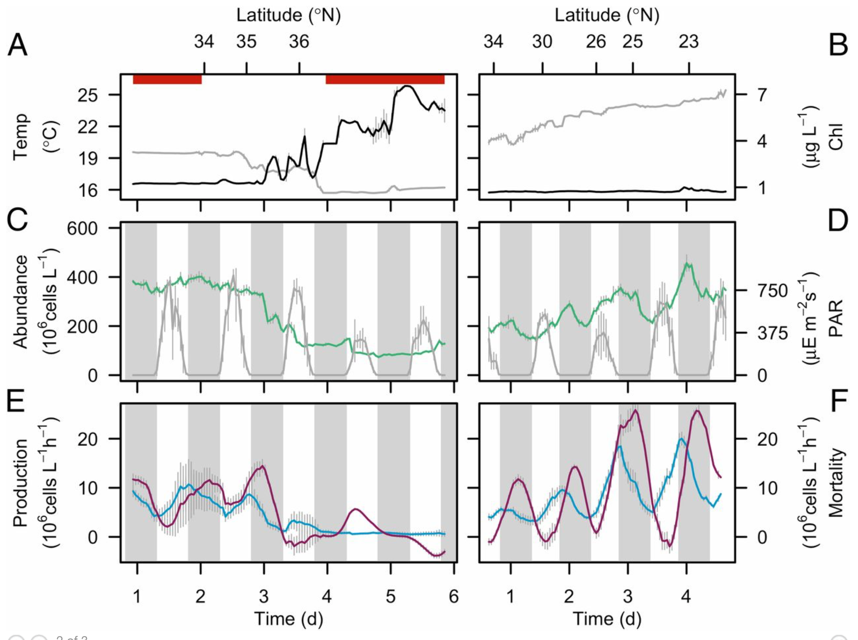
Light-driven synchrony of Prochlorococcus growth and mortality in the subtropical Pacific gyre
I. Daily rates
II. Hourly rates
Growth
Mortality
Growth
Growth
2 cruises in winter
Ribalet et al. 2015
https://doi.org/10.1073/pnas.1424279112

Slide 11
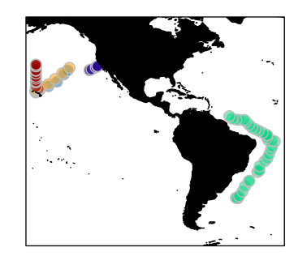
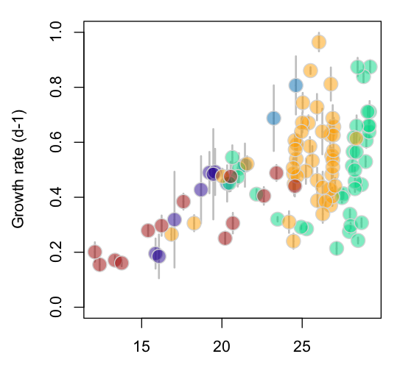
I. Daily rates of Prochlorococcus cell growth in surface waters
105 daily rates of cell growth in surface waters, paired with SST, PAR and nutrient concentrations (35 cruises).
Temperature (deg C)

Slide 12
I. Daily rates of Prochlorococcus cell growth in surface waters
105 daily rates of cell growth in surface waters, paired with SST, PAR and nutrient concentrations (35 cruises).
Thermal acclimation and nutrient availability control Prochlorococcus growth rates in surface waters
nutrient-
controlled
growth
temperature-controlled growth
temperature-nutrient
interactions
Temperature (deg C)

Slide 13
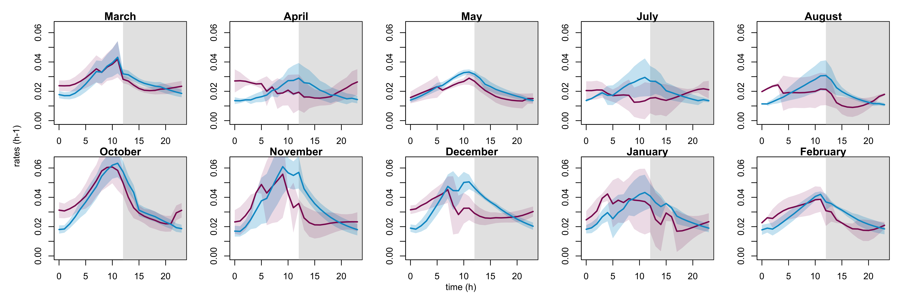
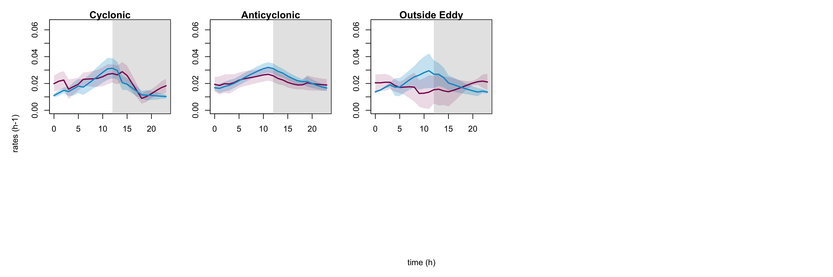
II. Diel coupling of Prochlorococcus growth and mortality in the subtropical gyre
Seasonality
Hourly Growth rates
Hourly Mortality rates
Mesoscale
Preliminary data suggest that the diel coupling of growth and mortality varies over the season and with the flow regime

Slide 14
hackathon
Particle size distribution composed of different species
Effect of size / time resolution on growth rate estimates
Allelometric carbon fixation and respiration rate

